Slide 1
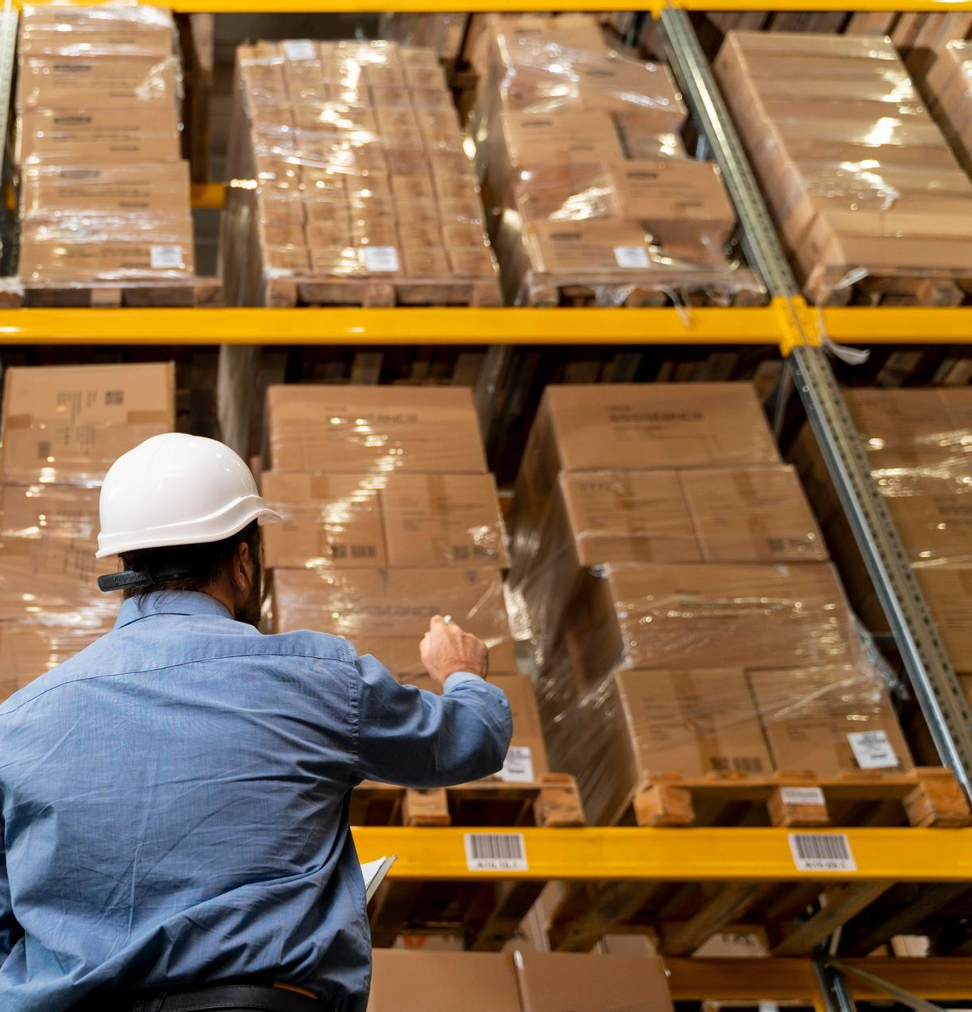
Inventory & Warehouse Management
Group 4’s Presentation

Slide 2
Table of contents
5.1 Inventory Management
5.1.1 Good Movement
5.1.2 Physical Inventory
5.1.3 Logistic Strategy (FIFO, FEFO, LIFO)
5.1.4 Valuation Method
5.2 Organizational structure of the warehouse
5.3 Master Data
5.3.1 Material Master
5.3.2 Logistic Unit
5.3.3 Batch of goods & Lookup Batch of good’s information - Traceability
5.4 Warehouse management process

Slide 3
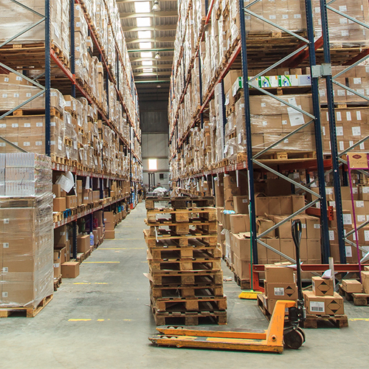
5.1
Inventory Management

Slide 4
What is a inventory management ?
Inventory management refers to the process of overseeing and controlling the flow, storage, and utilization of inventory or stock within a business or organization.
In inventory and warehouse management, defining the warehouse has 2 types:
+ Physical inventory
+ Book inventory
Functions of inventory management include:
+ Good movement
+ Physical inventory
+ Valuation methods
+ Logistics strategy.

Slide 5
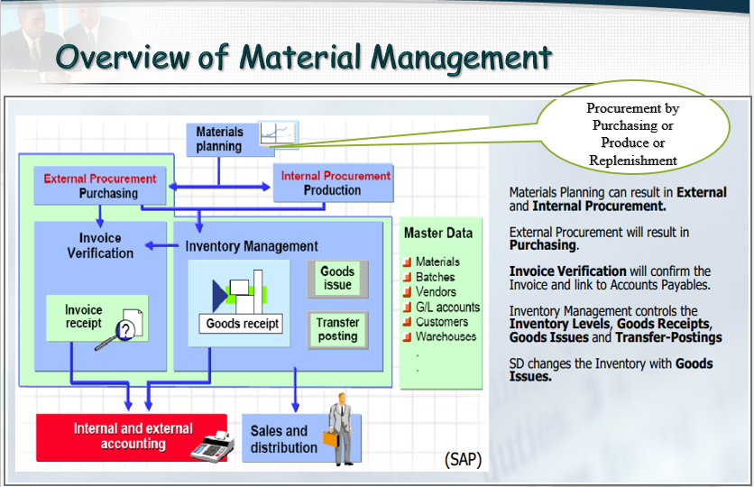

Slide 6
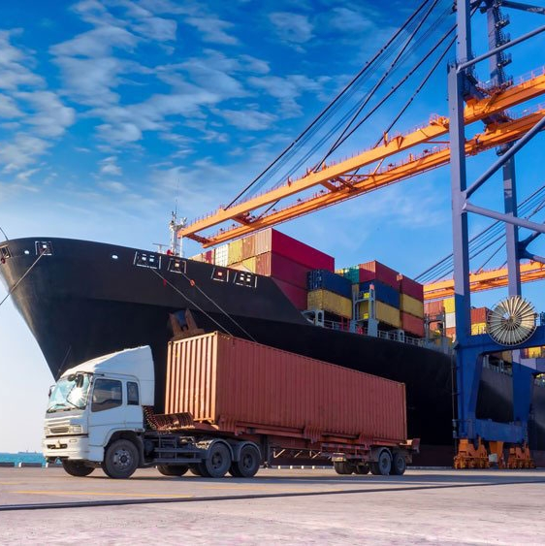
5.1.1 Good Movement
Good movement refers to the physical transfer or relocation of goods within warehouse environment. It involves the movement of products from one location to another, such as from a supplier to a warehouse, between warehouses, or from a warehouse to the end customer.

Slide 7
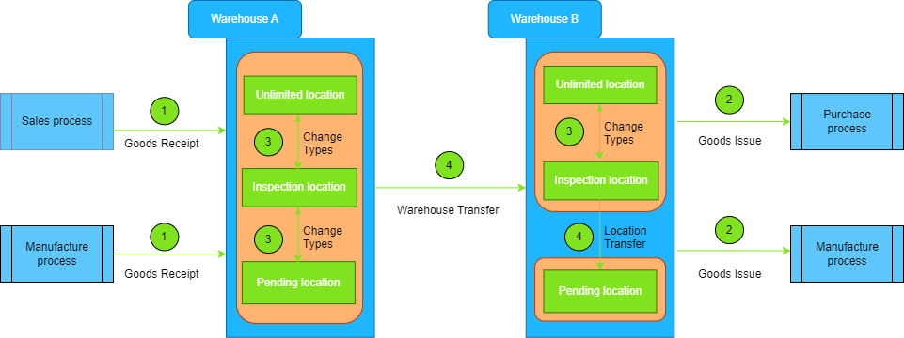
Types of good movement

Slide 8
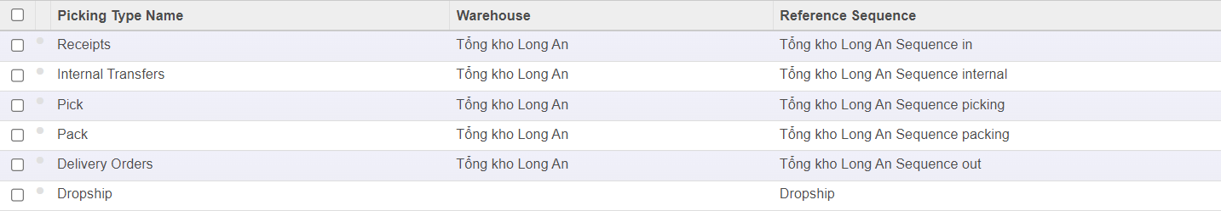
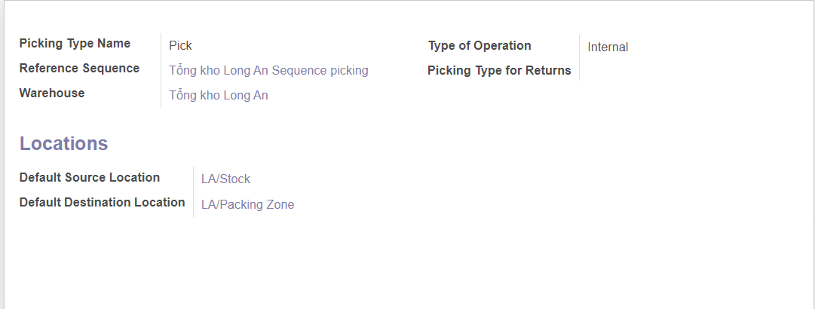
Warehouse transfer are defined in Odoo

Slide 9

Goods Receipt
Goods receipt refers to the process of recording the receipt of goods or products into a warehouse or inventory system. It involves receiving, inspecting, and verifying the quantity, quality, and condition of the received goods.

Slide 10

Goods Issue
Good issue is the movement (removal) of goods or materials out of the warehouse. In short, it means the issuance of goods or materials from the warehouse to the production or manufacturing process unit. When goods are issued, it reduces the number of stock in the warehouse.

Slide 11
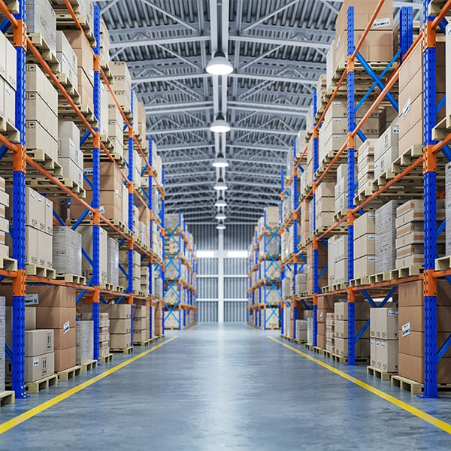
Change Types
It is an activity that deals with the management of the nature of the goods rather than the quantity and location of the goods.
In Odoo use the document as Internal Stock Move to perform this feature.

Slide 12
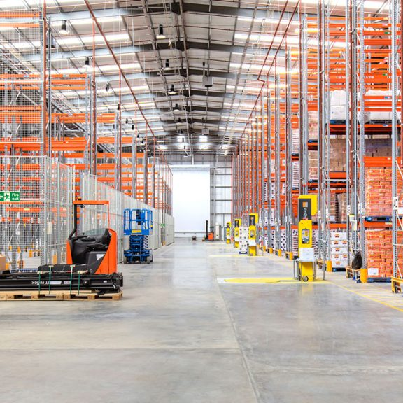
Stock Transfer
Stock transfer refers to the process of moving inventory or stock from one location to another within a warehouse or between different warehouses.
There are three types of stock transfer:
1-step: Use only one voucher (Internal Stock Move) to perform
2-step: Use two vouchers (2 Internal Stock Move) and manipulate those two vouchers.
Inter-company transfer: Apply to the corporation model with the requirement to coordinate goods between 2 companies in the same corporation.

Slide 13
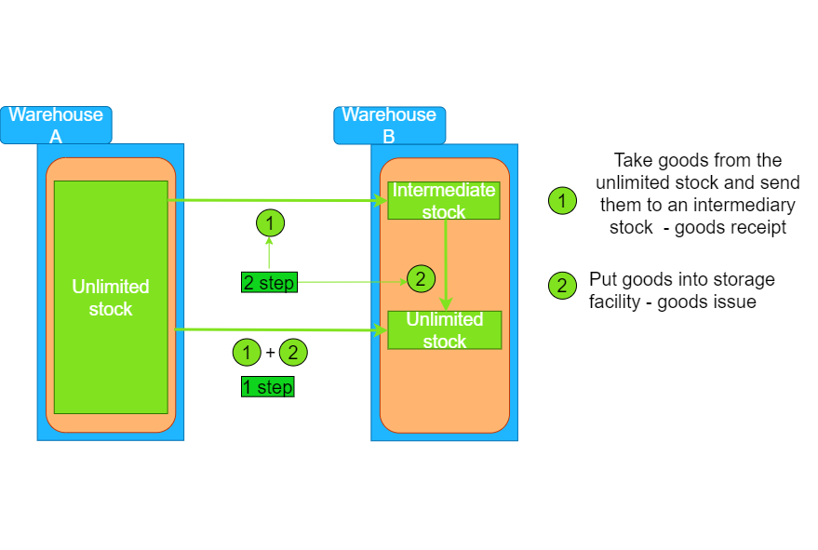
Stock relocation 1 step, 2 step

Slide 14
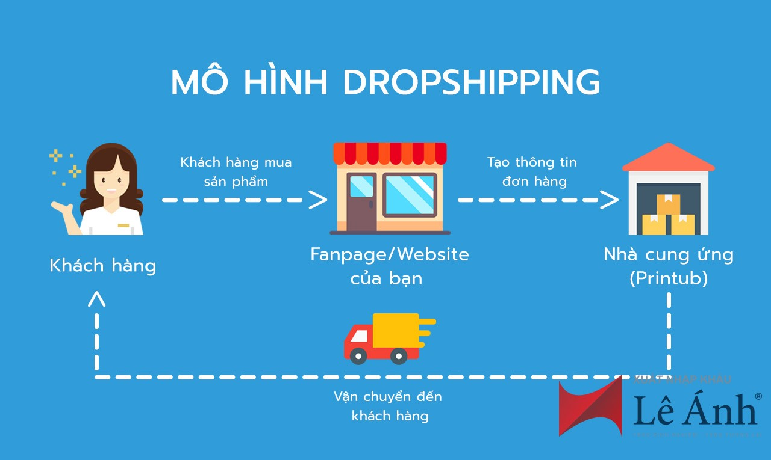
Drop Shipping
When a customer places an order (Sales Order form Drop Shipping), the company will contact the supplier (create a purchase order) to ship directly (using Drop Shipping vouchers) from the supplier's warehouse to the customer's warehouse.

Slide 15
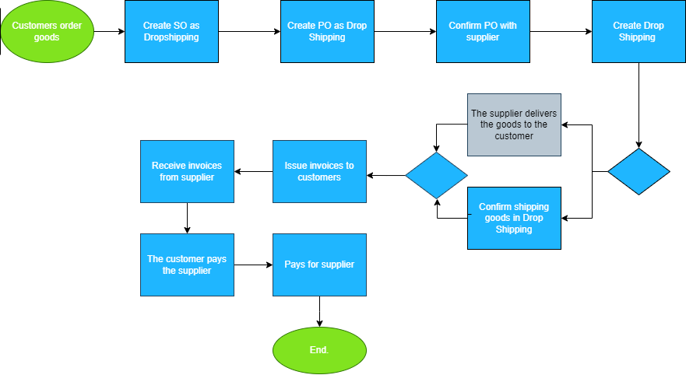
Sales process and Goods issue as Drop Shipping*

Slide 16
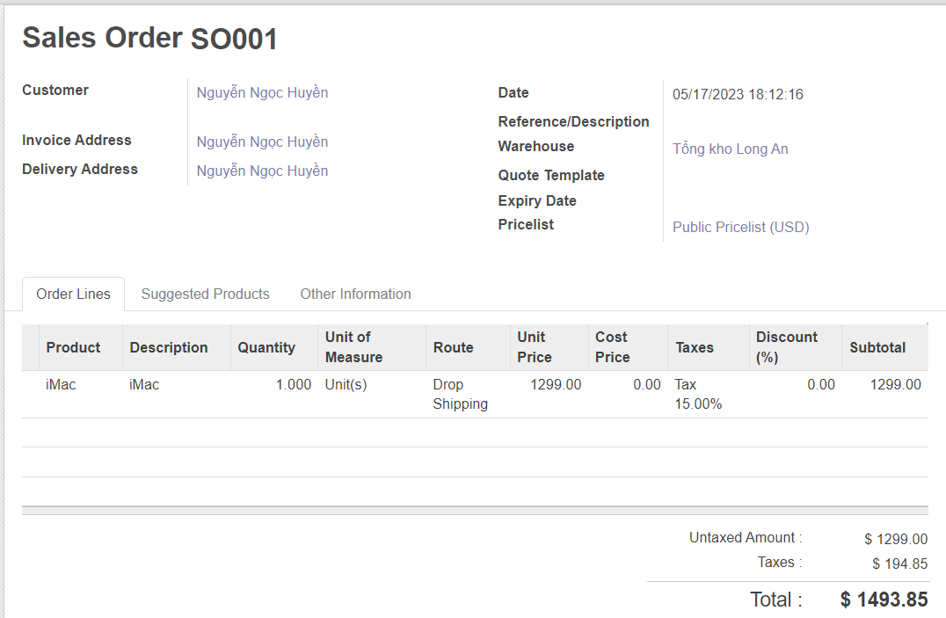
Sales process and Goods issue as Drop Shipping

Slide 17
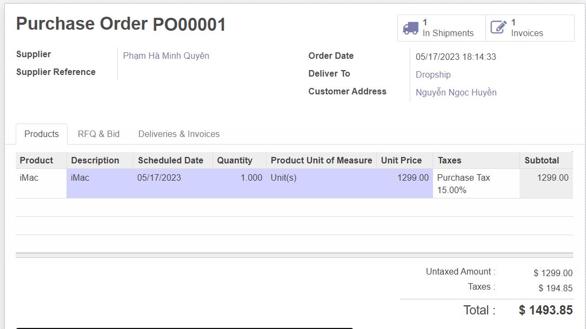
Purchase Order as Drop Shipping

Slide 18
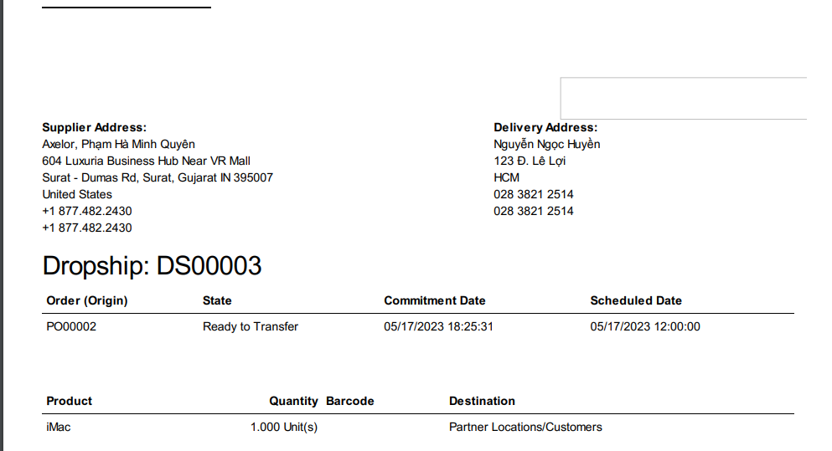
Document from Drop Shipping

Slide 19
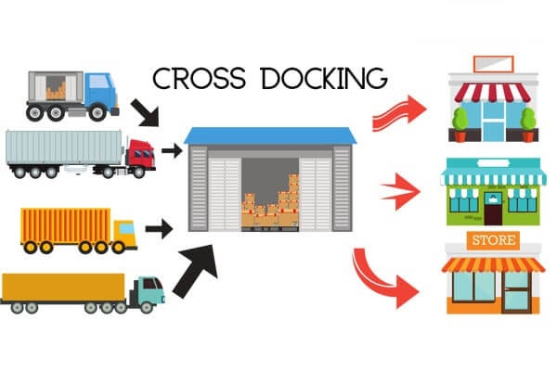
Cross Docking
Cross Docking goods will be purchased from suppliers and sent to the company's warehouse, the goods will not be stored in the warehouse but directly to the shipping area.
Goods are usually packed into Logistic units (LU).

Slide 20
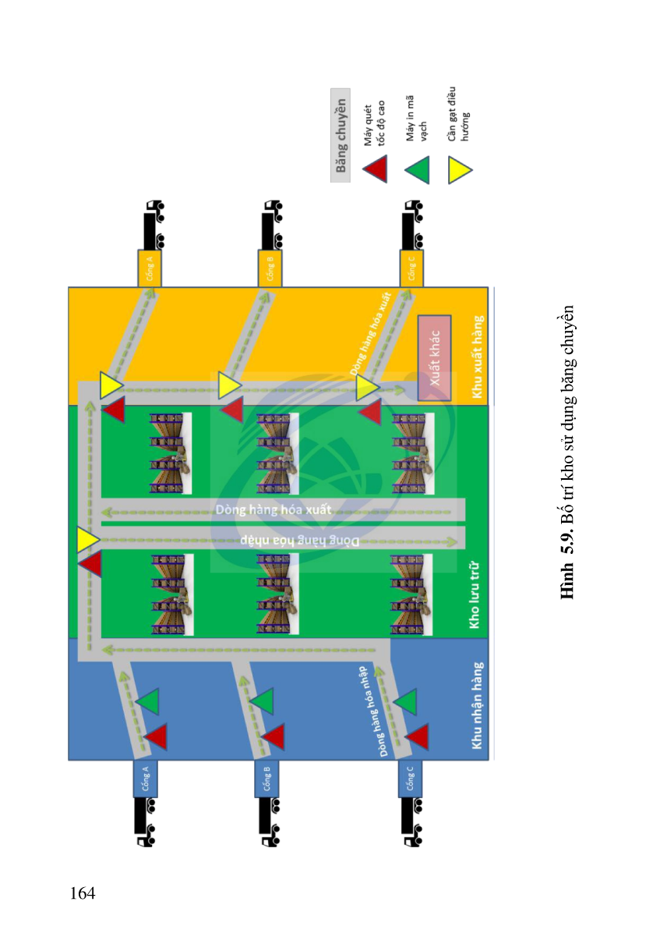

Slide 21
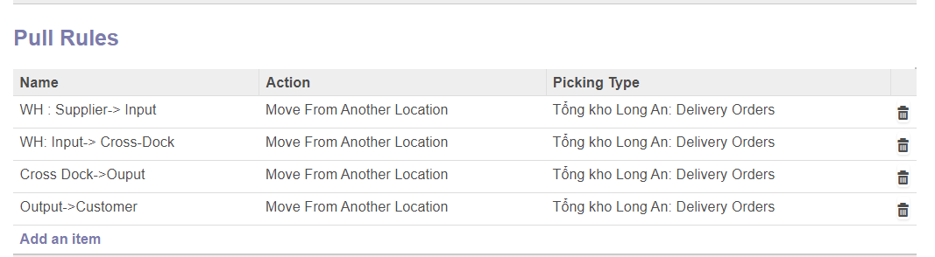
Pull Rule for Cross Dock location

Slide 22
5.1.2 Physical Inventory
An activity that takes place every month, quarter or 6 months. The purpose of physical inventory activity is to tally each SKU (Stock keeping Unit), to update the actual quantity.

Slide 23
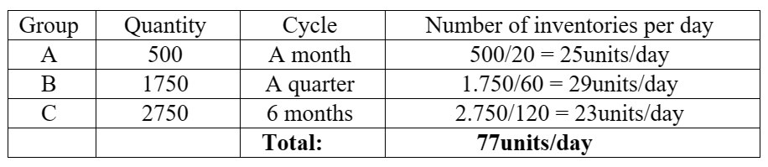
Physical inventory according to ABC*

Slide 24
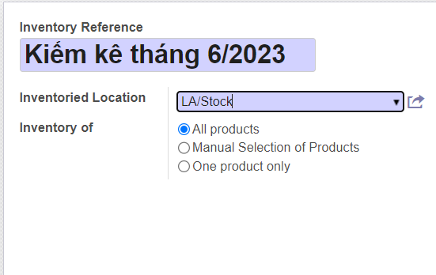
Create new physical inventory activity

Slide 25
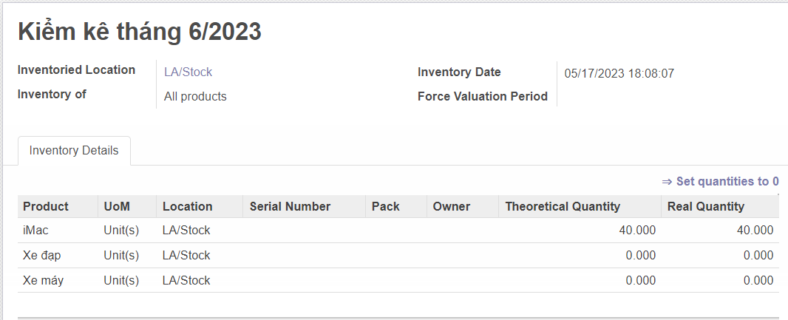
Implementation physical inventory process

Slide 26
5.1.3 Logistic Strategy
The logistics strategy for inventory is the way to determine the priority when releasing the warehouse. There are 3 main types of strategies:
+ FIFO (First In First Out)
+ LIFO (Last In First Out)
+ FEFO (First Expiry First Out)

Slide 27
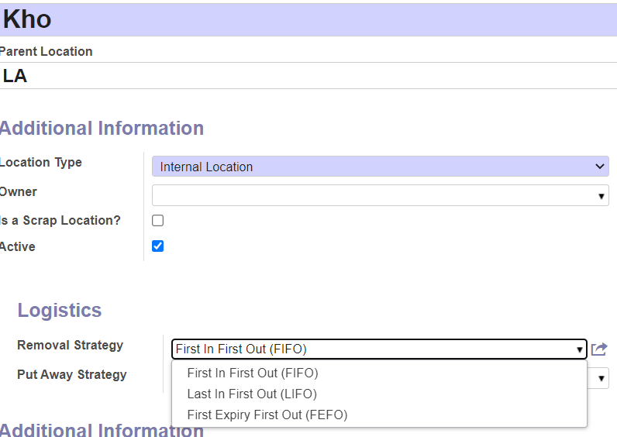
Configure logistics strategy for inventory

Slide 28
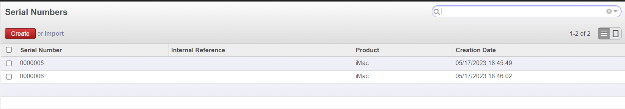
2 lots purchased at different time

Slide 29

First In First Out (FIFO)
The FIFO strategy is an inventory management method whereby applied to ensure that the oldest received inventory will be used or shipped out first, help reducing the risk of product obsolescence, expiration or spoilage.

Slide 30
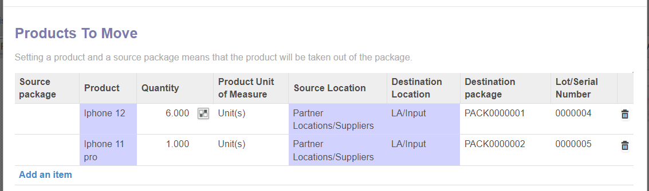
Automatically select shipments according to the strategy

Slide 31
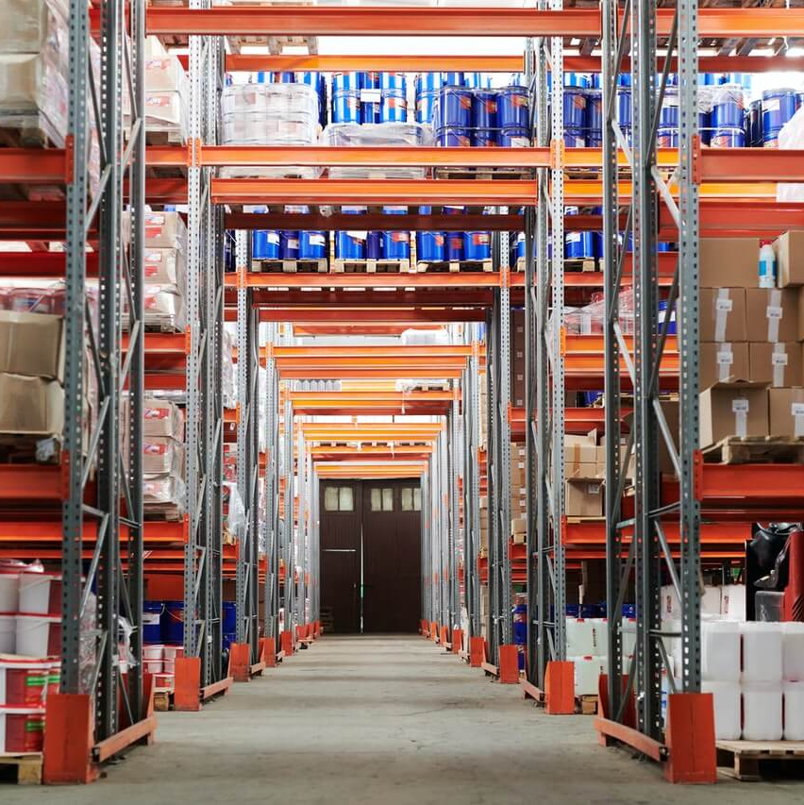
Last In First Out (LIFO)
LIFO is a mechanism of storage, where the goods which are stored last that are to be used first. This technique is primarily used whenever non-perishable goods are being stored.

Slide 32
First Expiry Fỉ r s First Expiry First Out (FEFO)
FEFO is to ensure that product with the shortest expiry date is placed into the market first. This makes it possible to reduce business overheads from wastage and cost associated with returns.
It also helps to ensure that products reaching end users have sufficient remaining shelf life.*

Slide 33
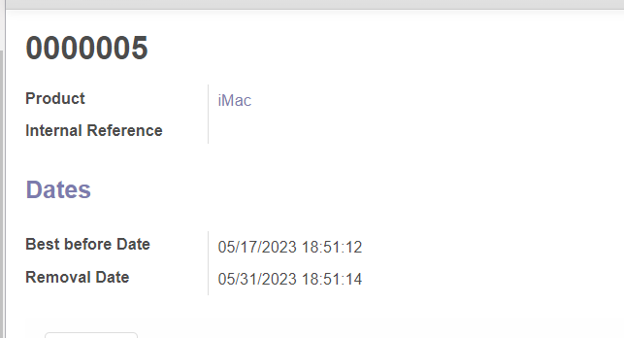
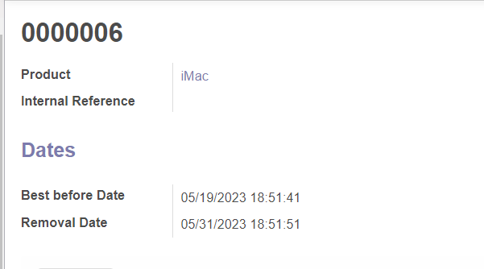
Expiry date of 2 batches for FEFO

Slide 34
5.1.4 Valuation Methods
The price of the finished product is valued in three basic ways:
+ Average Price
+ Real Price
+ Fixed price

Slide 35

Average Price
Average price is calculated by taking the sum of the values and dividing it by the number of prices being examined.
Example buy 2 batches of iMac
+ lot A (20 units with cost 2000 Euros), + lot B (20 units with cost 2200 Euros) . So, product cost will be 2100 Euros/unit.

Slide 36
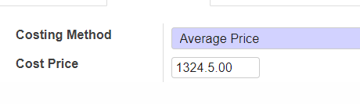
Automatically select shipments according to the strategy

Slide 37

Real Price
When the goods are purchased, they have different values (as in the example above) , when selling any lot, the price is exactly equal to the value at the time of purchase of that lot.*

Slide 38
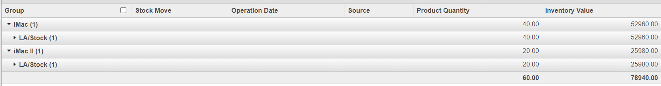
Automatically select shipments according to the strategy

Slide 39

Fixed Price
A fixed-price strategy means you set a price and keep it constant for an extended period of time.
Example: Basic car services, such as oil changes, transmission flushes and tire rotations, are commonly quoted with fixed pricing.

Slide 40
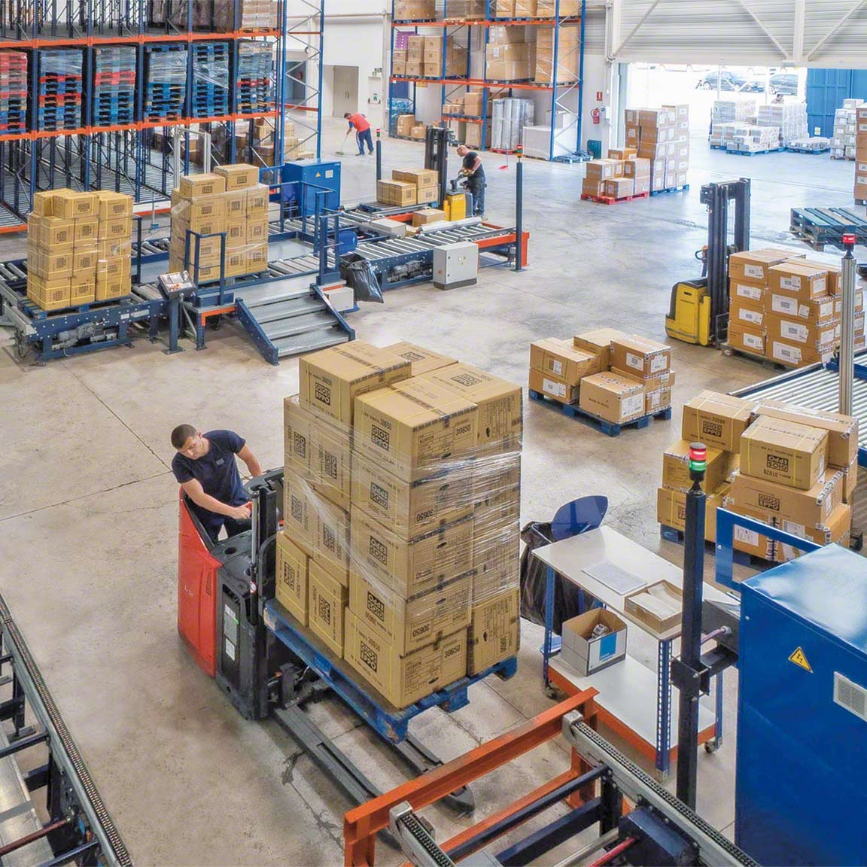
5.2
Organizational structure of the warehouse

Slide 41
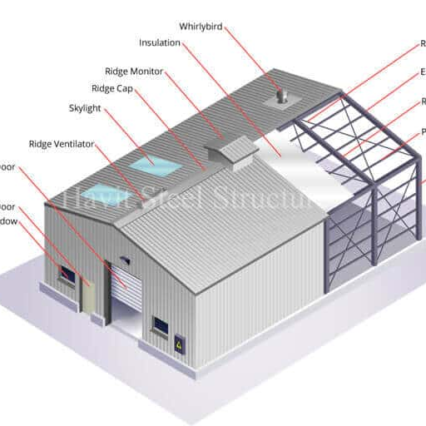
In Odoo, It is divided into 2 concepts: Warehouse and Location.
+ Warehouse: is physical warehouse, can be used to production, distribution center.

Slide 42
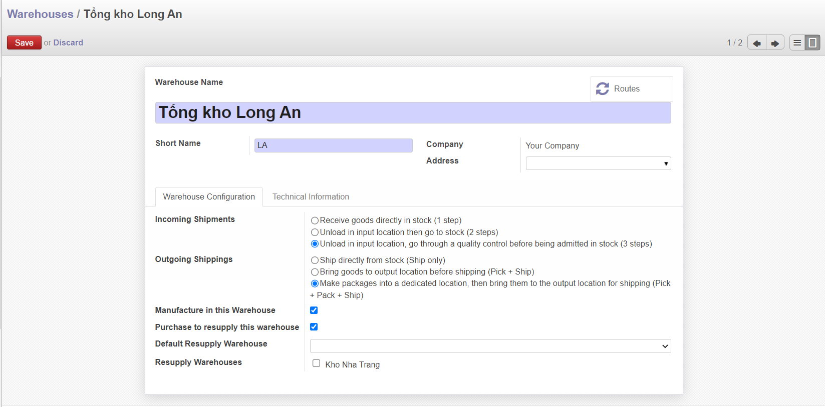
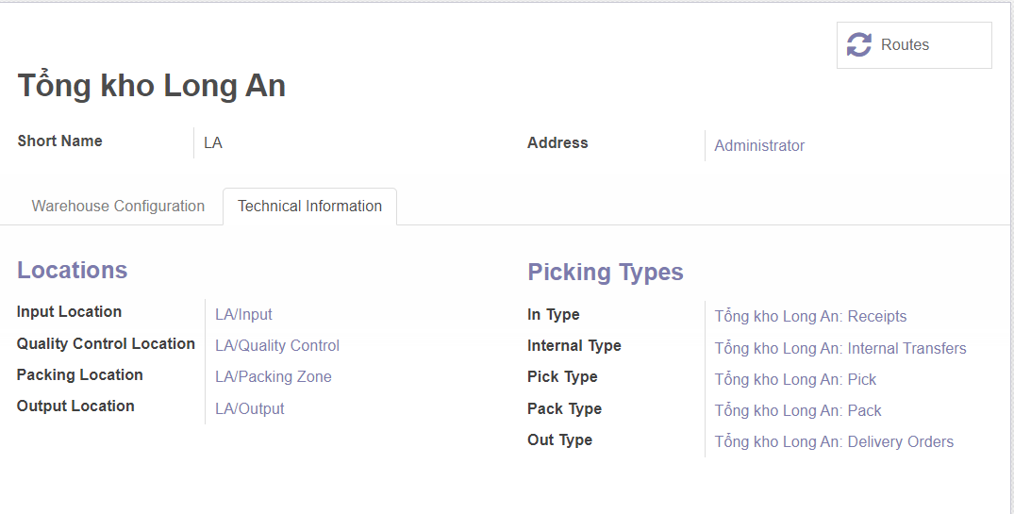
Information of warehouse

Slide 43
+ Location: Warehouse divided into many locations, each location have different function. The warehouse has the following types: Internal Location, Supplier Location (Virtual Location), Customer Location(Virtual Location), general repository(serving for inter-company warehouse transfer).

Slide 44
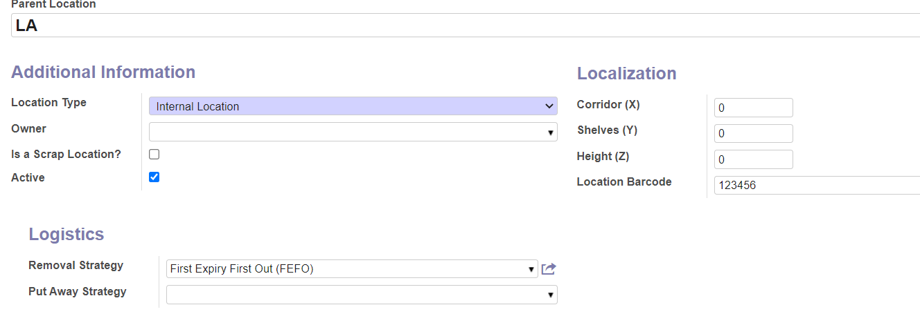
Information of location

Slide 45

5.3
Master Data

Slide 46
5.3.1 Material master
Material master is used for managing warehouse that include:
+ Lot management
+ Item location in warehouse
+ Weight and volume: gross weight (gross), net weight (net), volume of 1 product unit (volume)
+ Product status information: normal, in development, end of life, obsolete.

Slide 47
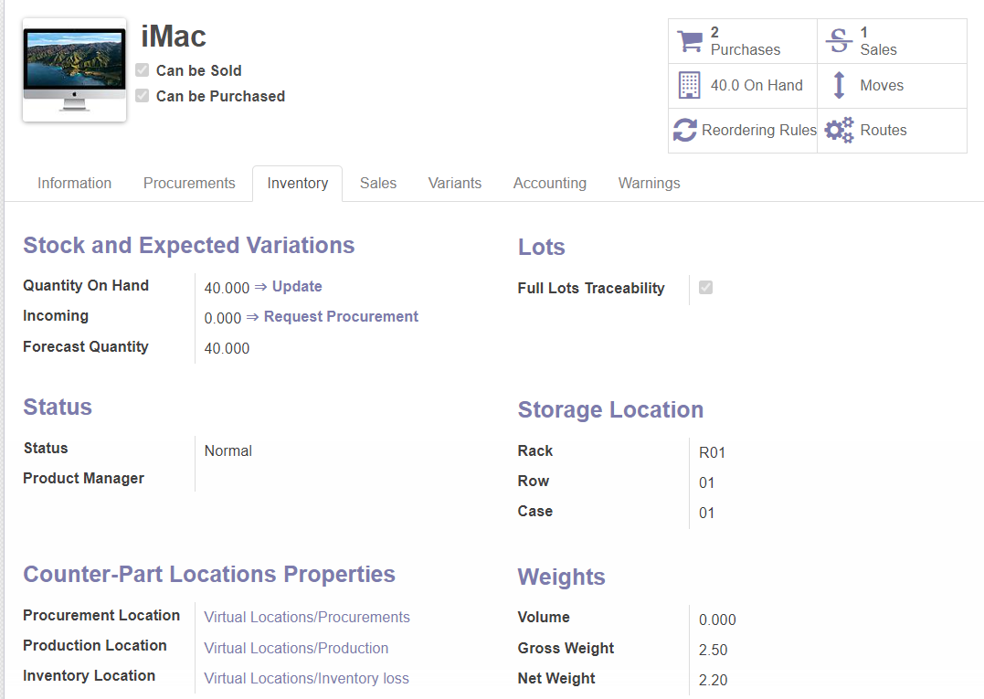

Slide 48
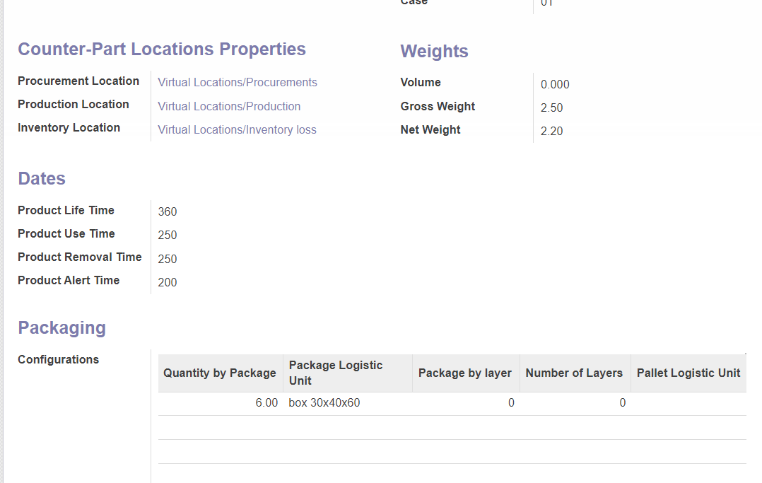
Master data of warehouse product

Slide 49
5.3.1 Material master
+ Information about expiry date: number of days used to calculate the expiry date of the product.

Slide 50
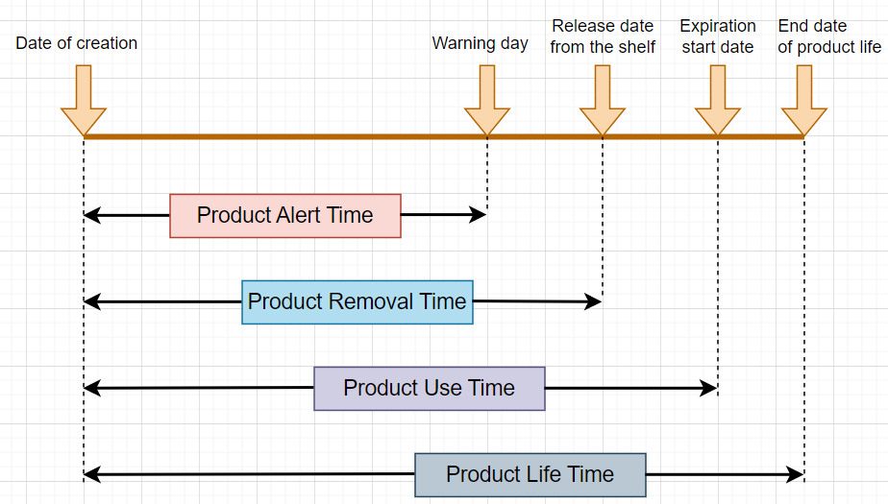
The expiry date of the production

Slide 51
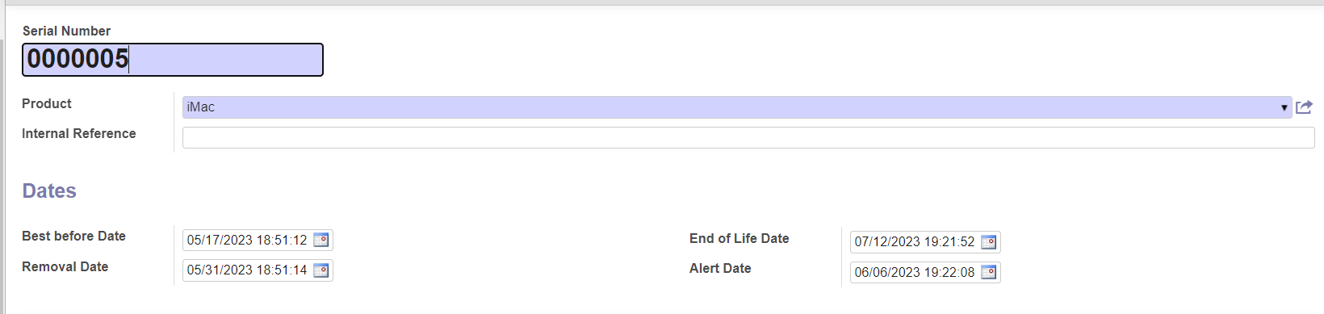
Self-generated batch code with corresponding expiry date

Slide 52
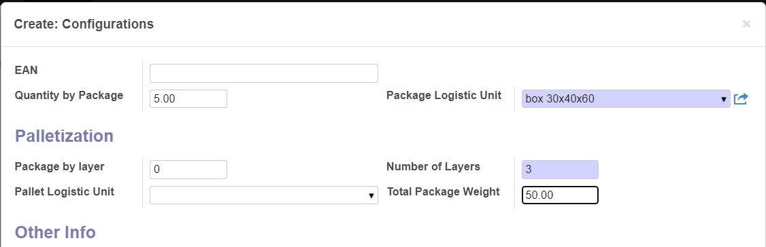
+ Information about packaging(Packaging): use Logistic Unit for packing, How many units of product can 1 LU hold.
Information about packaging

Slide 53
5.3.2 Logistic Unit
- When importing and exporting goods, the product will be packed based on the logistics unit. It can be boxes, pallets, packages.

Slide 54
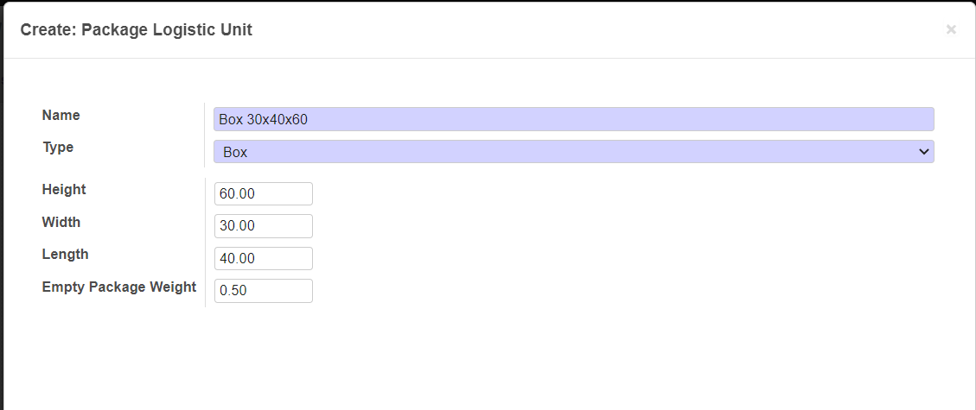
Logistic Unit

Slide 55
5.3.3 Batch of goods & Lookup Batch of good’s information – Traceability.
- A production lot refers to a specific quantity of a product or assembly that is produced within a particular production run and has uniform characteristics. This production lot may consist of multiple individual units of the same product, which can then be packed into different types of packaging, such as boxes, cartons, or pallets.

Slide 56
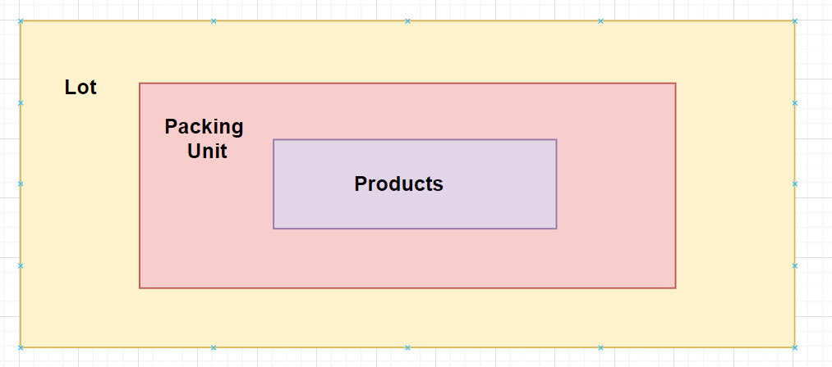
Logistic Unit

Slide 57
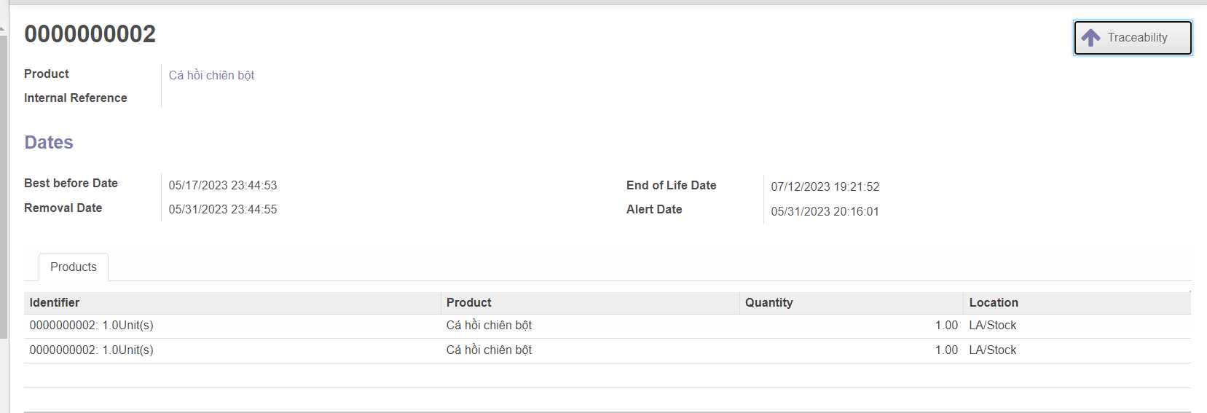
Shipment and transaction history to shipment

Slide 58
5.3.3 Batch of goods & Lookup Batch of good’s information – Traceability.
- Lookup Batch of goods’s information: Each product after being released from stock is packaged and the packaging contains product information and batch of product.

Slide 59
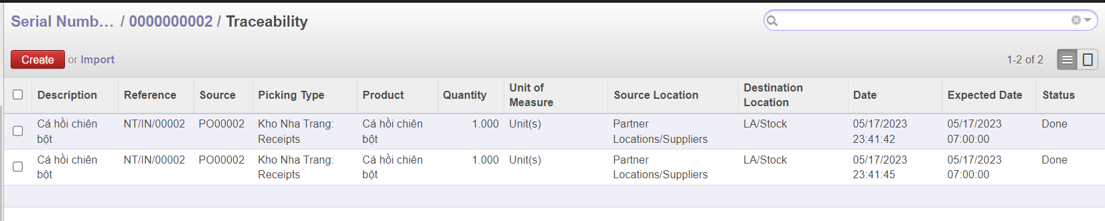
Lookup information of product

Slide 60
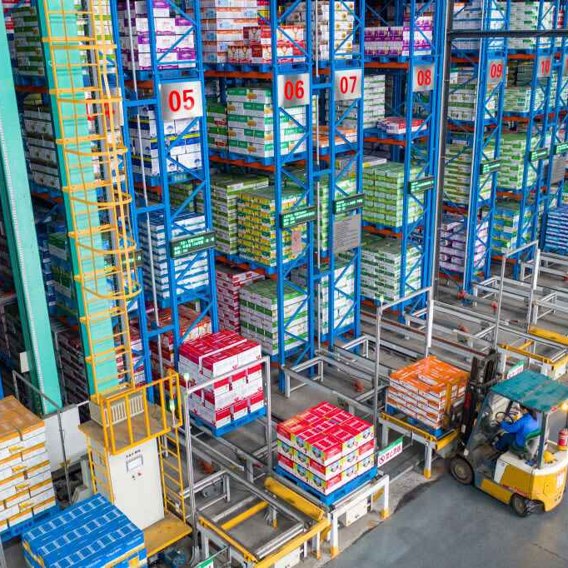
5.4
Warehouse management process

Slide 61
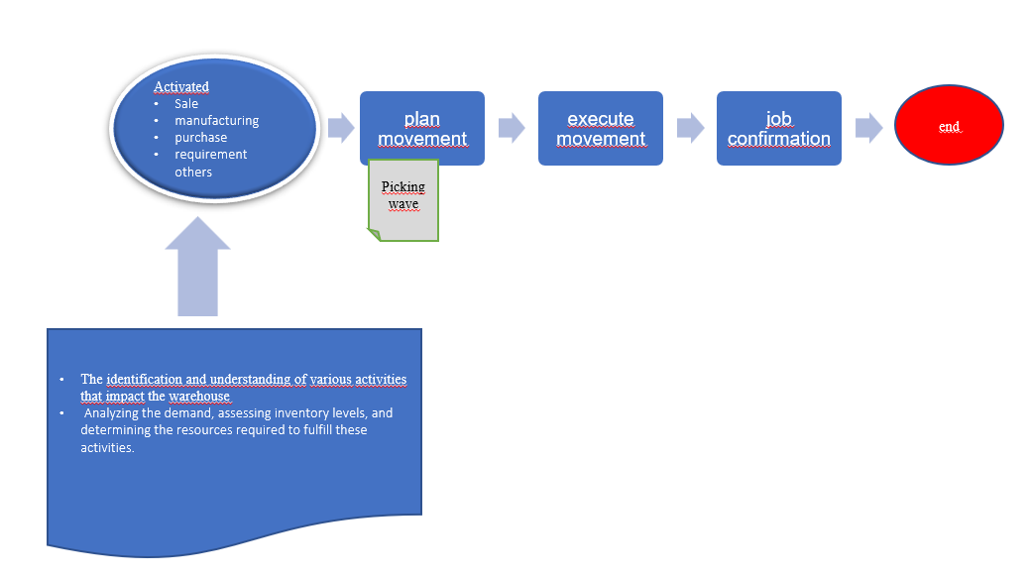

Slide 62
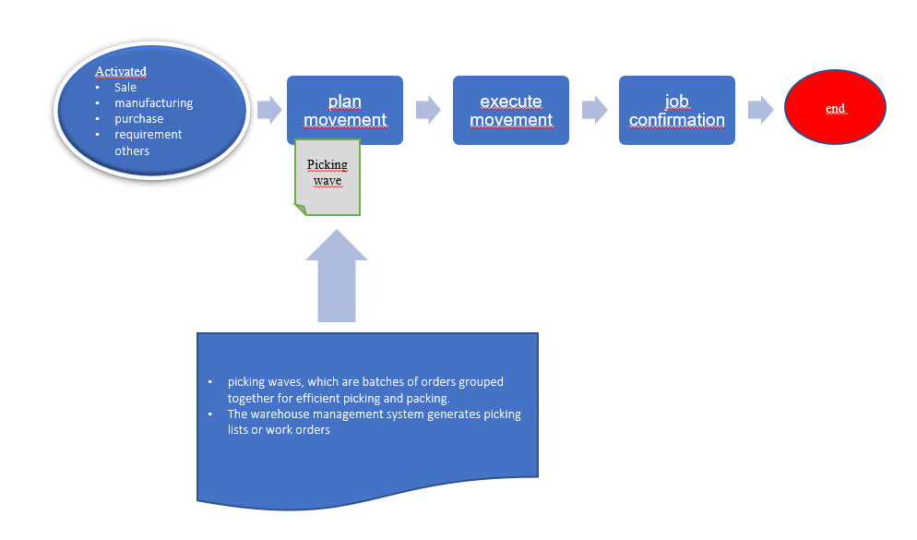

Slide 63
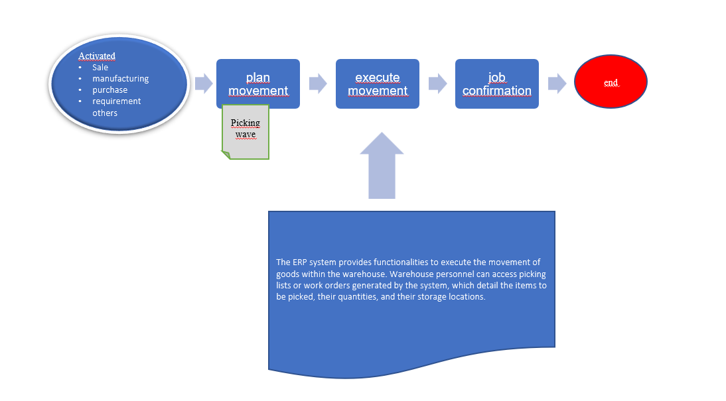

Slide 64
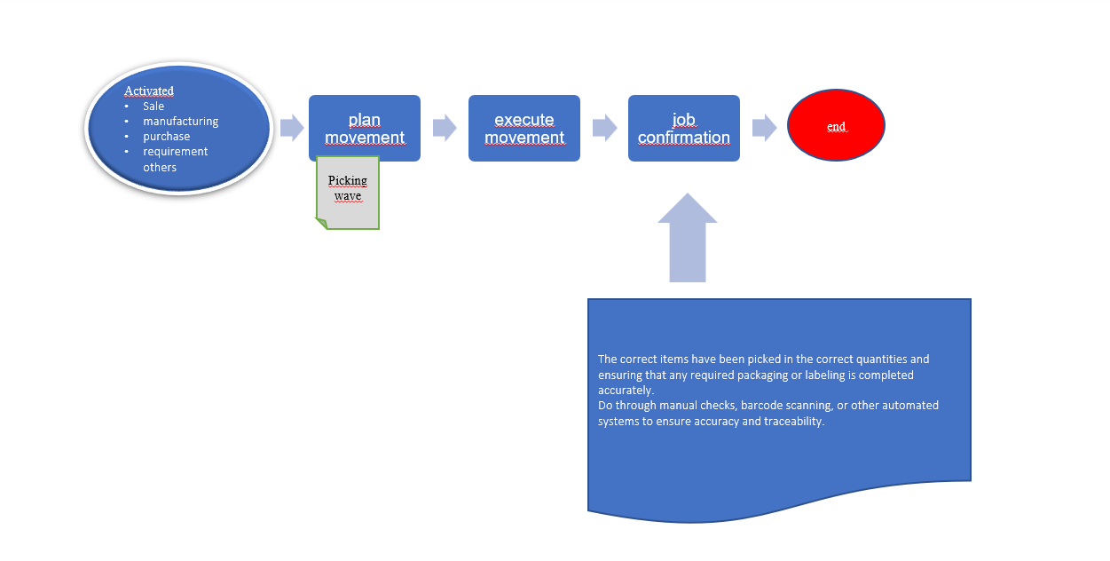

Slide 65
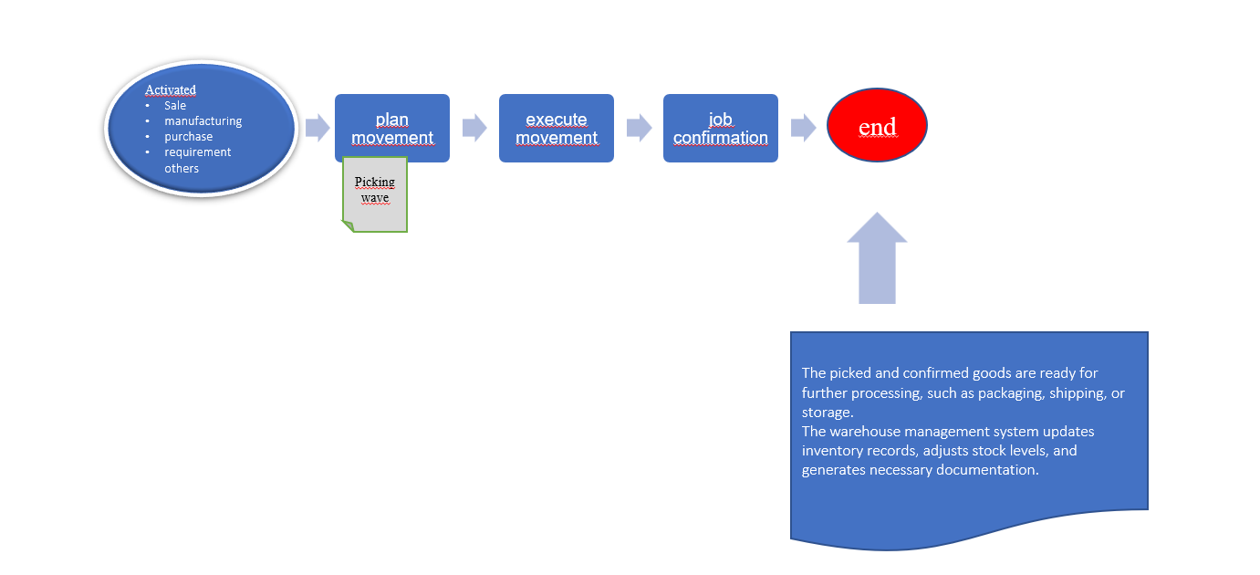

Slide 66
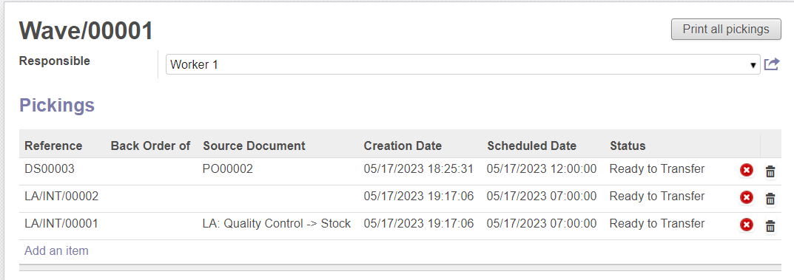
Picking Wave in Odoo

Slide 67

Dashboard for all types plan movement in the warehouse and DropShiping

Slide 68

Dashboard for all types plan movement in the warehouse and Drop Shiping

Slide 69

References:
PGS.TS Nguyễn Đình Thuân, Ths Đỗ Duy Thanh, Hoạch định nguồn lực doanh nghiệp - ERP, published in 2016.

Slide 70


